Slide 1

Initial analysis

Slide 2
Summary I – Data types, file formats and utilities
Annotation: Genomic regions
Genes
Peaks
bedtools
Alignment: Map reads
BAM/SAM
Samtools
Aggregation: Summary files
Wig (UCSC)
TDF (IGV)

Slide 3
Summary II – Data process
Short read alignment (Bowtie, BWA)
Making the genome searchable: Hashing/BW
Seed an extend (hashing) vs suffix searches (BW)
New aligners are mix
Spliced aligners (TopHat, STAR, GSNAP)
Map read fragments then strung them
Choosing the fragment size
Avoiding biases using information (junctions)
Quantifying (RSEM/Cufflinks)
Read/Isoform assignment
Normalization procedures
Differential expression (DESeq/EdgeR/Cufflinks)

Slide 4
Summary III – Using a graphical user interface
Galaxy – for knowledgable users who are not comfortable with UNIX
All tools available
Not great for many samples

Slide 5
Todays topics
Looking at ALL of your data

Slide 6
Comparing samples: Scatter plots

Slide 7
Raw counts/RPKMs are NOT Gaussian

Slide 8
... they are more like Log-Gaussian

Slide 9
And log counts/RPKM can be scatter-plotted

Slide 10
Which can also be looked at as an “MA-Plot”

Slide 11
Differential analysis: Lets revisit quantification
A
B
C
RNA-Seq quantification: Infer # molecules in A from observed fragments in C

Slide 12
Quantification assumptions for differential expression
Note: We can at best estimate

Slide 13
Modeling the RNA-Seq process
RNA-Seq counts should distribute “binomially”

Slide 14
Binomial? Why then we talk about Poisson

Slide 15
Binomial? Why then we talk about Poisson
RNA-Seq counts can be approximated by a Poisson distribution

Slide 16
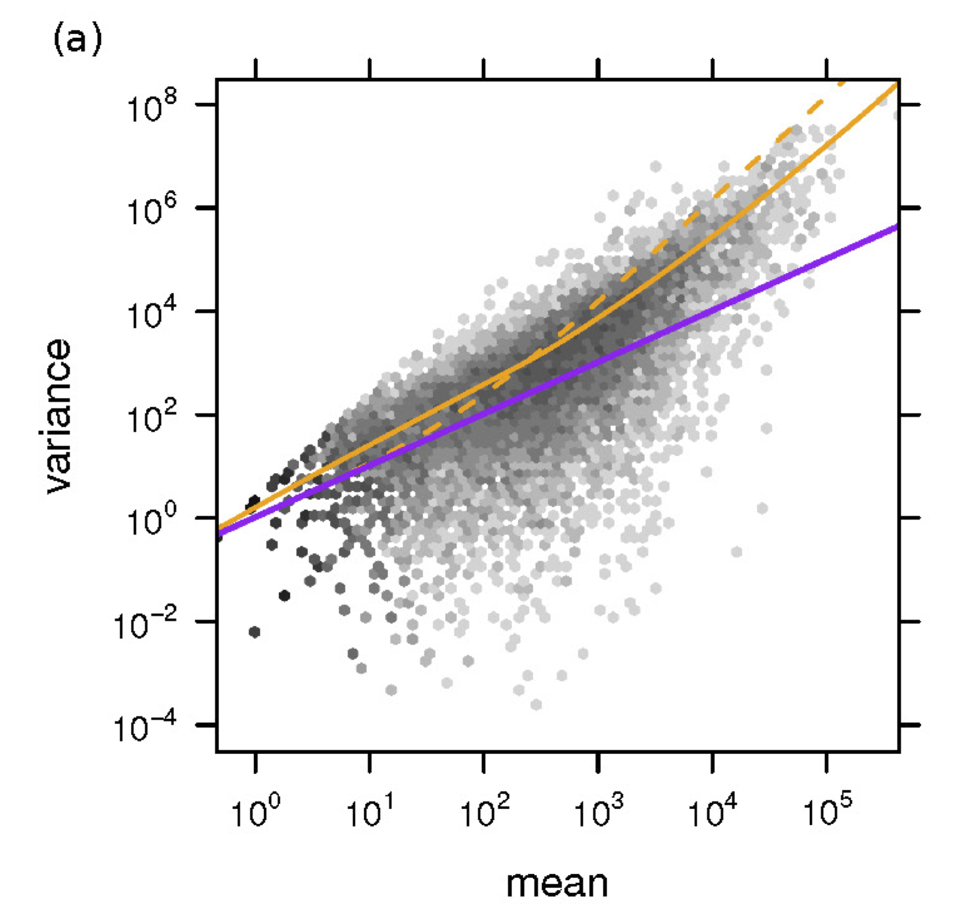
Poisson model does not work
Adapted from Anders, 2010
Solution: Use the negative binomial distribution

Slide 17
Hierarchical clustering – when are vector similar?
Gene | Cond1 | Cond2 | Cond3 | Cond4
g₁ | 2.5 | 5 | 7.5 | 10
g₂ | 0.2 | 0.5 | 0.8 | 1.1
g₃ | 0.2 | 0.3 | 0.4 | 11
g₄ | 2.5 | 8 | 8 | 9
Clustering is about similarity:
Between two rows (specified by a distance function)
Between two sets of rows (specified by the linkage method)

Slide 18
Common similarity approaches
Distance between rows (or columns)
Correlation: d(r,s) = (1- cor(r,s))/2
Euclidean: d(r,s) = sqrt(Σ_{i}(r_{i} – s_{i})²)
Linkage: Distance betwee two sets (d(R,S))
Complete:
Average:
Single:
Gene | Cond1 | Cond2 | Cond3 | Cond4
g₁ | 2.5 | 5 | 7.5 | 10
g₂ | 0.2 | 0.5 | 0.8 | 1.1
g₃ | 0.2 | 0.3 | 0.4 | 11
g₄ | 2.5 | 8 | 8 | 9

Slide 19
The effect of the linkage method
Gene | Cond1 | Cond2 | Cond3 | Cond4
g₁ | 2.5 | 5 | 7.5 | 10
g₂ | 0.2 | 0.5 | 0.8 | 1.1
g₃ | 0.2 | 0.3 | 0.4 | 11
g₄ | 2.5 | 8 | 8 | 9

Slide 20
Effect of the distance!
Gene | Cond1 | Cond2 | Cond3 | Cond4
g₁ | 2.5 | 5 | 7.5 | 10
g₂ | 0.2 | 0.5 | 0.8 | 1.1
g₃ | 0.2 | 0.3 | 0.4 | 11
g₄ | 2.5 | 8 | 8 | 9

Slide 21
Playing with clustering
#Define the toy matrix#
#######################
m = rbind (c(2.5,5,7.5,10), c(0.2,0.5,0.8,1.1), c(0.2,0.3,0.4,11), c(2.5,8,8,9))
#Give column and row names#
###########################
rownames(m) = c("g1","g2","g3","g4");
colnames(m) = c("c1","c2","c3","c4");
#Compute the correlation distance matrix#
#########################################
submat.dist = as.dist( (1 - cor(t(m)) ) /2 );
#Plot clustering with the three main methods#
#############################################
plot( hclust(submat.dist, method="complete",members=NULL), main="Complete linkeage - correlation", sub="", xlab="", lwd=3);
plot( hclust(submat.dist, method="average",members=NULL), main = "Average Linkeage - correlation", sub="", xlab="", lwd=3);
plot( hclust(submat.dist, method="single",members=NULL), main = "Single Linkeage- correlation", sub="", xlab="", lwd=3);
#Plot clustering with the three main methods, using the euclidean distance#
###########################################################################
plot( hclust(dist(m), method="complete",members=NULL), main="Complete linkeage - euclidean", sub="", xlab="", lwd=3);
plot( hclust(dist(m), method="average",members=NULL), main = "Average Linkeage - euclidean", sub="", xlab="", lwd=3);
plot( hclust(dist(m), method="single",members=NULL), main = "Single Linkeage - euclidean", sub="", xlab="", lwd=3);

